Slide 1
Construction of Three Phase Induction Motor

Slide 2
The three phase induction motor is the most widely used electrical motor.
Almost 80% of the mechanical power used by industries is provided by three phase induction motors because of its simple and rugged construction, low cost, good operating characteristics, the absence of commutator and good speed regulation.
In three phase induction motor, the power is transferred from stator to rotor winding through induction.
The induction motor is also called asynchronous motor as it runs at a speed other than the synchronous speed.
3 Phase Induction Motor Construction
Like any other type of electrical motor induction motor, a 3 phase induction motor is constructed from two main parts, namely
stator
rotor

Slide 3
Stator
As its name indicates stator is a stationary part of induction motor.
A stator winding is placed in the stator of induction motor and the three phase supply is given to it.
The stator of the three-phase induction motor consists of three main parts :
Stator frame,
Stator core,
Stator winding or field winding.
Rotor:
The rotor is a rotating part of induction motor.
The rotor is connected to the mechanical load through the shaft.
The rotor of the three phase induction motor are further classified as Squirrel cage rotor and Slip ring rotor or wound rotor or phase wound rotor. Depending upon the type of rotor construction used the three phase induction motor are classified as:
Squirrel cage induction motor
Slip Ring or Wound Rotor Three Phase Induction Motor

Slide 4
The other parts of a 3 phase induction motor are:
Shaft for transmitting the torque to the load. This shaft is made up of steel.
Bearings for supporting the rotating shaft.
One of the problems with electrical motor is the production of heat during its rotation. To overcome this problem, we need a fan for cooling.
For receiving external electrical connection Terminal box is needed.
There is a small distance between rotor and stator which usually varies from 0.4 mm to 4 mm. Such a distance is called air gap.

Slide 5
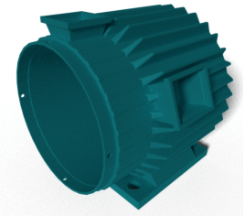
Stator Frame
It is the outer part of the three phase induction motor.
Its main function is to support the stator core and the field winding.
It acts as a covering, and it provides protection and mechanical strength to all the inner parts of the induction motor.
The frame is either made up of die-cast or fabricated steel.
The frame of three phase induction motor should be strong and rigid as the air gap length of three phase induction motor is very small.
Otherwise, the rotor will not remain concentric with the stator, which will give rise to an unbalanced magnetic pull.

Slide 6
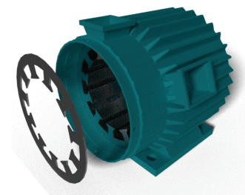
Stator Core
The main function of the stator core is to carry the alternating flux.
In order to reduce the eddy current loss, the stator core is laminated.
These laminated types of structure are made up of stamping which is about 0.4 to 0.5 mm thick.
All the stamping are stamped together to form stator core, which is then housed in stator frame.
The stamping is made up of silicon steel, which helps to reduce the hysteresis loss occurring in the motor.

Slide 7
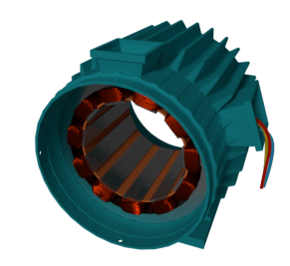
Stator Winding or Field Winding
The slots on the periphery of the stator core of the three-phase induction motor carry three phase windings.
We apply three phase ac supply to this three-phase winding.
The three phases of the winding are connected either in star or delta depending upon which type of starting method we use.
We start the squirrel cage motor mostly with star-delta stater and hence the stator of squirrel cage motor is delta connected.
We start the slip ring three-phase induction motor by inserting resistances so, the stator winding of slip ring induction motor can be connected either in star or delta.
The winding wound on the stator of three phase induction motor is also called field winding, and
when this winding is excited by
three phase ac supply it produces
a rotating magnetic field.

Slide 8
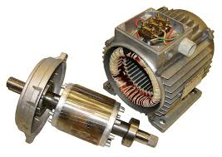
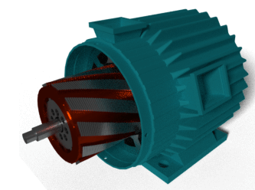
Squirrel Cage Rotor (Squirrel Cage Induction Motor)
The rotor of the squirrel cage three phase induction motor is cylindrical and have slots on its periphery.
The slots are not made parallel to each other but are bit skewed
the skewing prevents magnetic locking of stator and rotor teeth and makes the working of the motor more smooth aand quieter.
The squirrel cage rotor consists of aluminum, brass or copper bars
These bars are called rotor conductors and are placed in the slots on the periphery of the rotor.

Slide 9
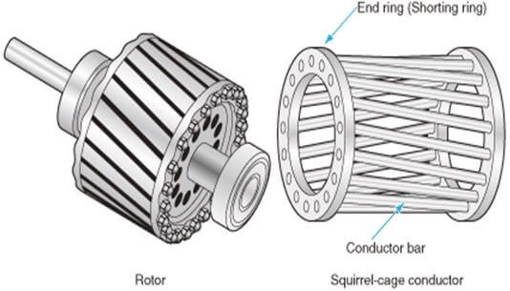
The rotor conductors are permanently shorted by the copper, or aluminum rings called the end rings.
These rotor conductors are braced to the end ring and hence form a complete closed circuit resembling like a cage and hence got its name as squirrel cage induction motor.
The absence of slip ring and brushes make the construction of Squirrel cage three-phase induction motor very simple and robust and hence widely used three phase induction motor.
These motors have the advantage of adopting any number of pole pairs.

Slide 10
Advantages of Squirrel Cage Induction Rotor
Its construction is very simple and rugged.
As there are no brushes and slip ring, these motors requires less maintenance.
Applications of Squirrel Cage Induction Rotor
We use the squirrel cage induction motors in lathes, drilling machine, fan, blower printing machines, etc

Slide 11
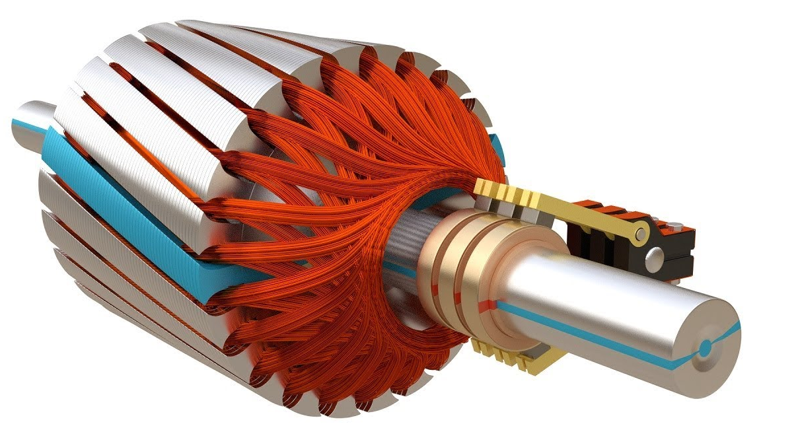
Slip Ring or Wound Rotor (Slip Ring Induction Motor)
In this type of three phase induction motor the rotor is wound for the same number of poles as that of the stator, but it has less number of slots and has fewer turns per phase of a heavier conductor.
The rotor also carries star or delta winding similar to that of the stator winding.
The rotor consists of numbers of slots and rotor winding are placed inside these slots.
The three ends of three-phase windings are permanently connected to these slip rings on the same shaft as that of the rotor. The three end terminals are connected together to form a star connection.

Slide 12
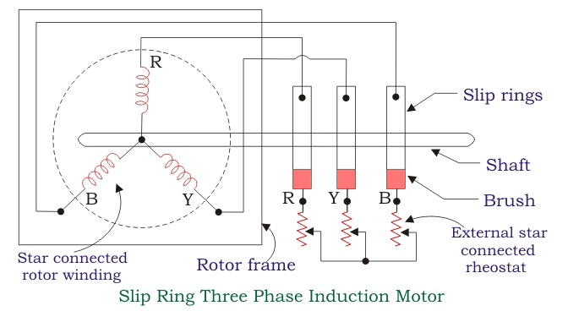
The external resistance can be easily connected through the brushes and slip rings and hence used for speed controlling and improving the starting torque of three phase induction motor.
The brushes are used to carry current to and from the rotor winding.
These brushes are further connected to three phase star connected resistances.
An electrical diagram of a slip ring three phase induction motor is shown below:

Slide 13
At starting, the resistance is connected to the rotor circuit and is gradually cut out as the rotor pick up its speed.
When the motor is running the slip ring are shorted by connecting a metal collar, which connects all slip ring together, and the brushes are also removed.
This reduces the wear and tear of the brushes.
Due to the presence of slip rings and brushes the rotor construction becomes somewhat complicated therefore it is less used as compare to squirrel cage induction motor.
Advantages of Slip Ring Induction Motor
It has high starting torque and low starting current.
Possibility of adding additional resistance to control speed.
Application of Slip Ring Induction Motor
Slip ring induction motor are used where high starting torque is required i.e in hoists, cranes, elevator etc.

Slide 14
